Slide 1
DEATH OF A RECORD TITLE OWNER:
SOLVING ESTATE RELATED TITLE PROBLEMS IN COLORADO
Lisa V. Perry, Esq.
Julie A. Clark, Esq.
Welborn Sullivan Meck & Tooley, P.C.
1125 17th Street, Suite 2200
Denver, Colorado 80202
(303) 830-2500
lperry@wsmtlaw.com
jclark@wsmtlaw.com

Slide 2
Probate Terminology
Testate: died with a Will
Intestate: died without a Will
Probate: The process of having a Will admitted into probate making it a legally binding document.
Administering an Estate: Process of collecting assets, paying creditors and distributing the estate to beneficiaries.

Slide 3
Probate Terminology cont’d
Executor: person named in a Will to probate the Will and to administer the estate.
Administrator: person with statutory priority to administer an estate; usually in intestate estates.
Personal Representative: person with authority to administer an estate – refers to both executors and administrators

Slide 4
Probate Terminology cont’d
Devisee: Person who will inherit under a Will.
Heir: Person who has statutory authority to inherit from a decedent in an intestate estate.
Beneficiary: General term for anyone who will inherit from an estate either as a devisee or an heir.

Slide 5
Informal Probate Process in 1 Slide
File a petition with the District Court of the County in which the decedent lived
  Probate Will (if testate)
  Appoint PR
Issue Letters Testamentary/of Administration
Collect assets and pay creditors
Distribute the remaining assets to the beneficiaries
File with the court a Statement closing the estate
Letters good for 1 year from date Statement is filed

Slide 6
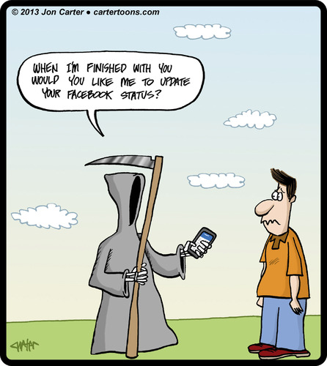
Death Prior to the Uniform Probate Code (UPC)

Slide 7
Dan is the record owner of a mineral interest in Weld County.
Instead of a PR deed and Letters, the real property records include probate documents for Dan’s Estate.
Is this sufficient to transfer title?

Slide 8
It depends.
UPC adopted for deaths after July 1, 1974
Prior to UPC, title passed by recording certain probate documents depending upon:
  Testate v. Intestate;
  Distribution v. Sale; and
  Original v. Ancillary probate
  Tax liens valid for 15 years (release no longer needed)
  Will is clear as mud – re-open probate or court

Slide 9
Pre-UPC Requirements:
Insufficient documents or
Nothing of record
Record required probate documents if:
  Dan died before July 1, 1974 and
  Estate was opened
Same as post-UPC requirements: Open probate and distribute estate (record PR deed and Letters) OR court determination (record court order) if:
  Dan died before July 1, 1974 and
  No estate was opened

Slide 10
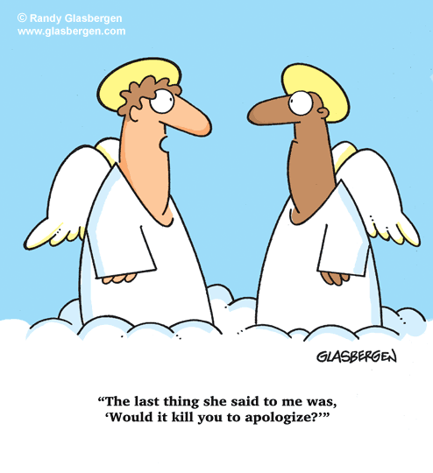
No Letters of appointment recorded with PR deed

Slide 11
The real property records include a PR deed but no Letters of Appointment.
Is this sufficient to pass title?

Slide 12
No.
Letters are required to show PR’s authority to act and must be recorded either with the PR deed or separately.

Slide 13
A little more about
Letters Testamentary/of Administration
Confirm the following from the face of the Letters:
  Issued by a Colorado Court;
  Grantor in deed is same person appointed in Letters;
  Date the Letters were issued is before the deed was signed;
  No restrictions; and
  Certified to be in effect no more than 60-days prior to date of deed.

Slide 14
Sample Letters

Slide 15
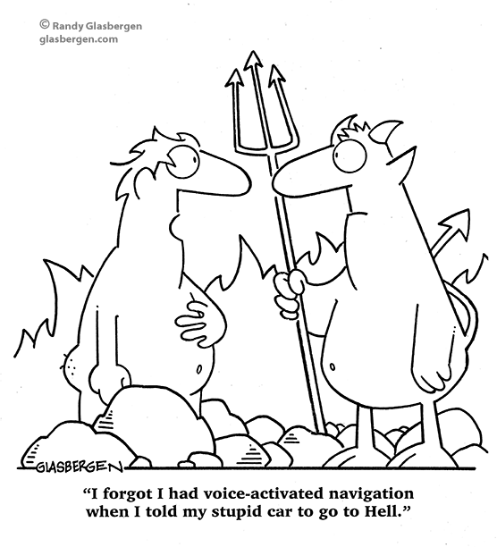
PR Appointed by Another State –
Ancillary Probate

Slide 16
The real property records include a PR deed and Letters issued by another State’s court
(“foreign Letters”).
Is this sufficient to pass title?

Slide 17
No.
Must open an ancillary probate in Colorado and record with the PR Deed:
Certified copy of the Certificate of Ancillary Filing – Decedent’s Estate
  Signed by the Clerk of the Colorado District Court
Certified copy of the foreign Letters

Slide 18
A Little About Ancillary Probate
Assume Dan died in Travis County, Texas owning MI in Weld County, Colorado
Original probate v. Ancillary probate
Original Probate in County/State where Dan lived at the time of death – Travis County, Texas
PR appointed by a Texas court has power over:
  Dan’s personal property wherever located; and
  Dan’s real property in Texas
PR does not have authority over real property located in other states.

Slide 19
Ancillary Probate cont’d
Ancillary Probate -- Give the Texas PR authority over Dan’s MI in Colorado by filing with the Weld County District Court:
  Domiciliary Foreign Personal Representative’s Sworn Statement and
  Certified copy of foreign Letters
Weld County Clerk will then issue a Certificate of Ancillary Filing
NOTE: only need to open Ancillary probate in one Colorado County

Slide 20
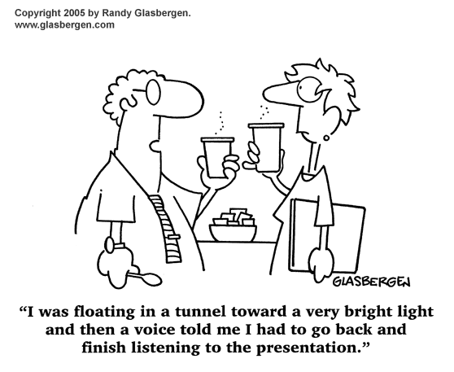
Who can lease minerals,
PR or beneficiary?

Slide 21
Dan died owning a MI in Weld County.
Pamela was appointed PR by the Weld County District Court in Dan’s estate.
Harry is the sole beneficiary of Dan’s estate.
Rudy’s Oil Co. wants to acquire a lease covering Dan’s MI.
Who should sign the lease, Pamela or Harry?

Slide 22
Pamela, as PR, should sign the lease. Good idea to have Harry ratify the lease at some point.
If the MI has not been distributed and remains an asset of the estate:
  Pamela as PR has authority to issue lease (unless restricted by Letters)

Slide 23
Lease from PR or beneficiary cont’d
Interplay of two statutory provisions:
  §15-12-101: title to a decedent’s property passes to the beneficiaries of the estate at the moment of death, subject to administration of the estate.
  Beneficiaries have a vested interest subject to divestment by the PR
  §15-12-711: personal representative has the same power over the estate’s assets that the decedent had, in trust, however, for the benefit of any creditors and the beneficiaries of the estate

Slide 24
Lease from PR or beneficiary cont’d
Example 1: Rudy’s Oil obtains a lease with a 1/6 RI from Pamela as PR of Dan’s estate
  §15-12-714: protects third parties who in good faith deal with a personal representative for value (“BFP”), except that a third party is deemed to have notice of any restrictions listed in the Letters
  Pamela, as PR, owes a fiduciary duty to Harry and can be held personally liable for breaching her duty
  Subsequent owner of MI takes subject to the recorded lease – but ratification is a good idea.

Slide 25
Lease from PR cont’d
Example 2: Rudy’s Oil obtains lease from Harry and the MI is later distributed to Harry by a PR deed.
  Lease is valid because Harry’s interest is perfected.
  Harry acquires MI subject to his own lease.

Slide 26
Lease from PR cont’d
Example 3: Rudy’s Oil obtains a lease from Harry but Pamela, as PR, sells the MI to Bob (a third party BFP) to raise money to pay federal estate taxes.
  Harry’s interest was never perfected and was divested by the sale
  Bob (as BFP) acquires MI free of the lease to Rudy’s Oil

Slide 27
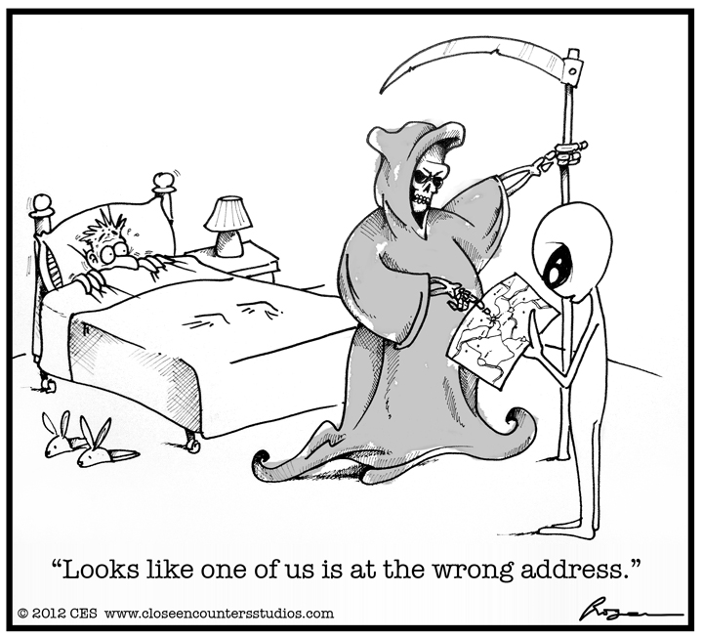
Affidavits of Heirship – Friend or Foe?

Slide 28
Dan is the record owner of a MI in Weld County.
Of record is an affidavit of heirship listing Harry as his only heir.
Is this sufficient to pass title?

Slide 29
No.
Harry does not acquire Dan’s MI until the MI is distributed to him by a PR Deed or by a court order.
  Marketable title: record PR Deed and Letters or record court order
Reality check: Operators rely upon affidavits of heirship for leasing or for small interest owners

Slide 30
A Little More About
Affidavits of Heirship
Who is signing the affidavit?
  Interested → people lie
  Disinterested → how well do you really know Dan?
Ask both interested and disinterested folks to hopefully get the full picture

Slide 31
Affidavits of Heirship -
Testate
Did they leave a Will? If so, do we care who the Heirs are? It depends.
Does the Will and intestacy statute differ?
Was the Will admitted into probate? If so, legally binding document and controls.
What if the Will wasn’t probated and differs from intestacy?
Wills can be sneaky:
  Cut out heirs
  Include heirs plus other beneficiaries
  Give to heirs in trust and not outright
Do not know for sure until the probate process plays out.

Slide 32
Affidavits of Heirship -
Intestate
Determining who owns what under Colorado’s intestacy statute.
Time machine -- determination is made based upon the laws and survivors at the time of death
Determine heirs based upon the intestacy statute at the time of death
People who survived the decedent inherit even if they have since died
Descendants who died before the decedent, then “per capita at each generation”
This can produce a different result then “per stirpes”, “per capita” and “by representation” – see chart attached to paper

Slide 33
What on Earth?
Current intestacy statute: The intestate share of a decedent's surviving spouse is:
(1) The entire intestate estate if:
(a) No descendant or parent of the decedent survives the decedent; or
(b) All of the decedent's surviving descendants are also descendants of the surviving spouse and there is no other descendant of the surviving spouse who survives the decedent;
(2) The first three hundred thousand dollars, plus three-fourths of any balance of the intestate estate, if no descendant of the decedent survives the decedent, but a parent of the decedent survives the decedent;
(3) The first two hundred twenty-five thousand dollars, plus one-half of any balance of the intestate estate, if all of the decedent's surviving descendants are also descendants of the surviving spouse and the surviving spouse has one or more surviving descendants who are not descendants of the decedent;
(4) The first one hundred fifty thousand dollars, plus one-half of any balance of the intestate estate, if one or more of the decedent's surviving descendants are not descendants of the surviving spouse.

Slide 34
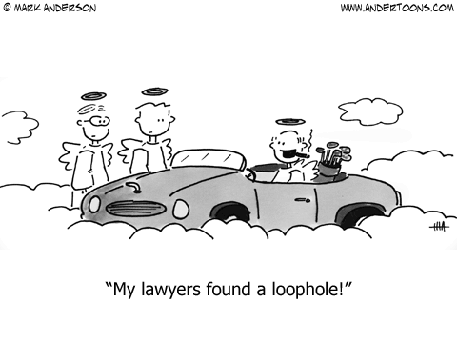
Thank you and happy Monday!

